Slide 1
CCCL - OAM Test Based Correlation using ML - Log AI Hackathon - 2025
Bhadrinath Eruventee,
Manohar SL,
Sorabh Ojha
OAM Explorers Team

Slide 2
CCCL - Cognitive Closed Control Loop: through OAM Test Based Correlation:
Problem statement
Architecture
Input data
ML Model details
Output data
Benefits
Future Evolution
Notes:
Impactful Advanced ML Use Case deployment still nascent in many customers
Everyone needs an AI Strategy; one key pillar of that strategy is that not all problems should be solved with AI
Technology looking for a problem, identification of killer use cases still under investigation by customers
Dealing with hallucinations & probability is common → Robust Validation Strategy
Network automation use cases traditionally rely on deterministic outcomes – managing hallucinations & probability needed
GenAI - A combination of a RAG with fine tuned LLMs provides the best results (so far).
Response Validation and Reinforcement Learning with Human Validation required
Data is the Fuel
A robust Data Strategy is key – generation, collection, storage, curation and processing and sharing
Data required to be voluminous, diverse, complete & consistent.
In all the experiments we had to curate, generate, correct and enrich data.
Use cases bring their specifics to use data, hence diverse strategies are required for chunking, embedding & ingestion of data.
Governance and privacy of data
Diverse deployment models
- Target on-premise and cloud options
** conversation point with the customer on their preference.
Compliance
Streamlined Legal and Security Compliance frameworks
Staff & Process to help product teams navigate the process to accelerate safe productization
Ethics and regulation
Consistent Tool Frameworks
Expedite experimentation
LLMOps tooling – optimize lab usage
Rohit:
Oh a few observations while we were experimenting with this I’m sure generative AI something which you all are kind of looking at and some capacity or the other. There are a few observations. It’s a good topic for sure. We do see that in telecom space adoption is that it’s nice like the technology is good we are looking at how to kind of take the cases and bring it to production so that everyone could be benefitted out of it very important what Sasha told is the fuel if you put garbage in to the last model, you get garbage out so working on your data architecture and getting your data cleaned is very very very important. Your deployment models can be diverse like you may want to air gap model versus hybrid model versus kind of model so the juries open which which one is the best of the right I think, depending on the time and the case, one is better than the other, the tooling it’s a good time to actually look and invest into the tooling so that you have the tooling frame your model evolution will continue your cleanup will continue but your tooling is kind of consistent and you can just all those improvements right so that’s that’s one observation a lot of time to talk with your lawyers because compliance to corporate guidelines to ensure that you don’t kind of pass away data which is critical some large language model is is very key last, but not the least very robust validation strategy is required because there’s a there’s you might have seen the GPT also hallucination is is real There are ways to contain it, but having a validation strategy would help the accuracy those refuse observations which we should share

Slide 3
Problem Statement
Manual failure analysis is time-consuming and inconsistent.
Need to automate correlation across DM, IGP, and Event data.
Objective: Identify why a DM test failed and which IGP link was responsible.
Use ML to highlight abnormal delay behavior.

Slide 4
Cognitive Closed Control Loop (CCCL)
What it means
A system that can observe the network, think using AI/ML, take action, and verify the result automatically.
Step | What Happens | Network Example
Observe | OAM collects stats | Delay, loss, jitter from SAP1 → SAP2
Analyze | ML detects anomaly / root cause | Abnormal delay on IGP-2
Decide | AI selects best action | Reroute traffic / flag link
Act | Control action executed | Switch from LSP-1 to LSP-2
Verify | OAM rechecks performance | Delay back to normal

Slide 5
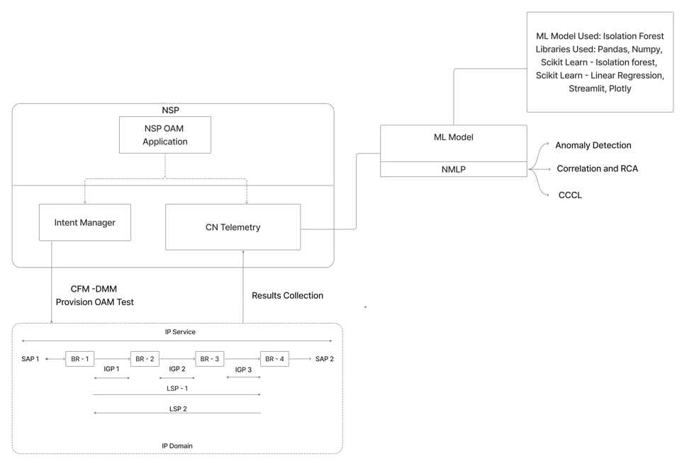
Architecture

Slide 6
OAM Stat | What it Means | Supervised ML Example | Unsupervised ML Example | Simple Network Example
Latency | Time from A → B | Classify as Normal / Congested | Detect sudden delay spike | Link delay jumps from 10 ms → 80 ms
Jitter | Delay variation | Predict voice quality issue | Detect unstable delay pattern | VoIP calls sound broken
Packet Loss | Missing packets | Classify link fault | Detect abnormal loss pattern | Packets dropped during peak traffic
Throughput | Actual data speed | Predict SLA violation | Detect performance degradation | 1 Gbps link delivering only 400 Mbps
Availability | Link up/down time | Classify link down event | Detect rare outage | Link goes down for 5 minutes

Slide 7
Implementation Details
Notes:
Impactful Advanced ML Use Case deployment still nascent in many customers
Everyone needs an AI Strategy; one key pillar of that strategy is that not all problems should be solved with AI
Technology looking for a problem, identification of killer use cases still under investigation by customers
Dealing with hallucinations & probability is common → Robust Validation Strategy
Network automation use cases traditionally rely on deterministic outcomes – managing hallucinations & probability needed
GenAI - A combination of a RAG with fine tuned LLMs provides the best results (so far).
Response Validation and Reinforcement Learning with Human Validation required
Data is the Fuel
A robust Data Strategy is key – generation, collection, storage, curation and processing and sharing
Data required to be voluminous, diverse, complete & consistent.
In all the experiments we had to curate, generate, correct and enrich data.
Use cases bring their specifics to use data, hence diverse strategies are required for chunking, embedding & ingestion of data.
Governance and privacy of data
Diverse deployment models
- Target on-premise and cloud options
** conversation point with the customer on their preference.
Compliance
Streamlined Legal and Security Compliance frameworks
Staff & Process to help product teams navigate the process to accelerate safe productization
Ethics and regulation
Consistent Tool Frameworks
Expedite experimentation
LLMOps tooling – optimize lab usage
Rohit:
Oh a few observations while we were experimenting with this I’m sure generative AI something which you all are kind of looking at and some capacity or the other. There are a few observations. It’s a good topic for sure. We do see that in telecom space adoption is that it’s nice like the technology is good we are looking at how to kind of take the cases and bring it to production so that everyone could be benefitted out of it very important what Sasha told is the fuel if you put garbage in to the last model, you get garbage out so working on your data architecture and getting your data cleaned is very very very important. Your deployment models can be diverse like you may want to air gap model versus hybrid model versus kind of model so the juries open which which one is the best of the right I think, depending on the time and the case, one is better than the other, the tooling it’s a good time to actually look and invest into the tooling so that you have the tooling frame your model evolution will continue your cleanup will continue but your tooling is kind of consistent and you can just all those improvements right so that’s that’s one observation a lot of time to talk with your lawyers because compliance to corporate guidelines to ensure that you don’t kind of pass away data which is critical some large language model is is very key last, but not the least very robust validation strategy is required because there’s a there’s you might have seen the GPT also hallucination is is real There are ways to contain it, but having a validation strategy would help the accuracy those refuse observations which we should share

Slide 8
Platform Used – Nokia Machine Learning Platform (NMLP)
The Enterprise Platform for R&D Machine Learning & AI within Nokia.
Supports the full model development lifecycle.
Key Features & Capabilities:
Unified Development: Jupyter Notebooks, VSCode, and Ray for scalable ML workloads.
Robust Orchestration: Kubernetes, Flyte (Workflow orchestration), and MLflow (Model Mgmt – End to End) for experiment tracking.
Integrated Data & Compute: DataHub for metadata, NESC integration, Harbor for container images, and secure storage.
Benefits:
Accelerate AI/ML experimentation projects and enhance collaboration among ML/AI practitioners.
Ensure secure and compliant machine learning development.
Important Notes:
All NMLP use cases must be submitted in Data Questor.
Adherence to Nokia AI Policy and Standard Operating Procedures (SOP) is mandatory.

Slide 9
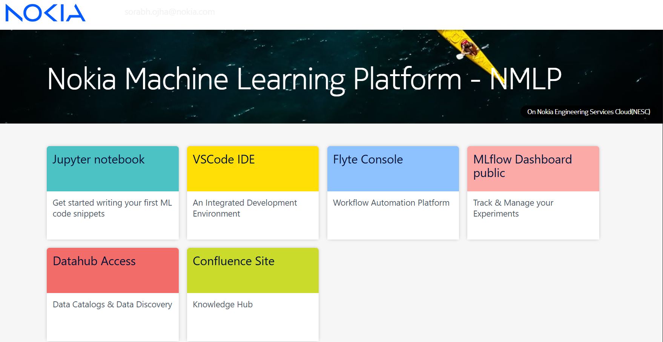
https://confluence.ext.net.nokia.com/display/aimlkh/Getting+Started+with+NMLP

Slide 10
Input Data – Data sources used
DM Data: Test results and delay values (Pass/Fail) – Timeseries Data
Generates large-scale synthetic DM telemetry with realistic timing and delay patterns
Introduces controlled contamination, where degraded samples show higher average delay and wider min–max spread
Enables safe validation of anomaly detection models using labeled, repeatable test data
Uses NumPy and pandas – generateSyntheticData.py

Slide 11
Input Data – Data sources used
IGP Data: Hop-wise latency per DM test
Purpose
Break a DM test’s end-to-end delay into per-IGP hop contributions
Create realistic path-level visibility for correlation and root-cause analysis
Delay Decomposition
Each LSP is modeled as a fixed number of IGP hops
Total DM delay is distributed across hops, preserving the end-to-end value
Ensures hop delays always sum back to the measured DM delay
Healthy vs Failure Behavior
PASS cases: Tighter, more even delay split across hops
FAIL cases: Higher variation across hops where one or more hops may dominate the total delay

Slide 12
ML Model Details – Modelling Approach
Model: Isolation Forest (unsupervised anomaly detection).
Uses an Isolation Forest as an unsupervised anomaly detection model to identify abnormal DM delay behavior without relying on labeled failures
Well-suited for skewed and noisy network data, where failures are rare and patterns change over time
Focuses on ranking abnormal behavior rather than hard classification, which aligns better with operational triage
Highly scalable (suitable for large data sets)
Unlabeled data
Can detect new anomalies outside existing patterns

Slide 13
ML Model Details – Modelling Approach
Trained globally on all DM delays → learns normal delay behavior -> Per IGP Level.
Applied only to FAILED tests to detect abnormal delay spikes.
Linear Regression used to compute IGP delay trend (Inc / Dec / Stable).
Model Logic (High Level)
Detects abnormal end-to-end DM behavior using an unsupervised Isolation Forest trained on delay patterns
Decomposes anomalous DM failures into per-IGP hop delays to localize the issue within the path
Identifies the most likely root-cause hop by comparing each IGP’s delay against its own healthy baseline
Adds context for explainability using hop delay trends and recent network events

Slide 14
Output Details – Consolidated Output
The pipeline produces a single consolidated output CSV.
Each failure record includes:
DM delay and anomaly score
Predicted root IGP link and its delay contribution
Link trend label (Increasing / Stable / Decreasing)
Most recent correlated network event (within a 1-hour window)
The output helps visualize what failed, where, and possibly why in one place.

Slide 15
Demo
Notes:
Impactful Advanced ML Use Case deployment still nascent in many customers
Everyone needs an AI Strategy; one key pillar of that strategy is that not all problems should be solved with AI
Technology looking for a problem, identification of killer use cases still under investigation by customers
Dealing with hallucinations & probability is common → Robust Validation Strategy
Network automation use cases traditionally rely on deterministic outcomes – managing hallucinations & probability needed
GenAI - A combination of a RAG with fine tuned LLMs provides the best results (so far).
Response Validation and Reinforcement Learning with Human Validation required
Data is the Fuel
A robust Data Strategy is key – generation, collection, storage, curation and processing and sharing
Data required to be voluminous, diverse, complete & consistent.
In all the experiments we had to curate, generate, correct and enrich data.
Use cases bring their specifics to use data, hence diverse strategies are required for chunking, embedding & ingestion of data.
Governance and privacy of data
Diverse deployment models
- Target on-premise and cloud options
** conversation point with the customer on their preference.
Compliance
Streamlined Legal and Security Compliance frameworks
Staff & Process to help product teams navigate the process to accelerate safe productization
Ethics and regulation
Consistent Tool Frameworks
Expedite experimentation
LLMOps tooling – optimize lab usage
Rohit:
Oh a few observations while we were experimenting with this I’m sure generative AI something which you all are kind of looking at and some capacity or the other. There are a few observations. It’s a good topic for sure. We do see that in telecom space adoption is that it’s nice like the technology is good we are looking at how to kind of take the cases and bring it to production so that everyone could be benefitted out of it very important what Sasha told is the fuel if you put garbage in to the last model, you get garbage out so working on your data architecture and getting your data cleaned is very very very important. Your deployment models can be diverse like you may want to air gap model versus hybrid model versus kind of model so the juries open which which one is the best of the right I think, depending on the time and the case, one is better than the other, the tooling it’s a good time to actually look and invest into the tooling so that you have the tooling frame your model evolution will continue your cleanup will continue but your tooling is kind of consistent and you can just all those improvements right so that’s that’s one observation a lot of time to talk with your lawyers because compliance to corporate guidelines to ensure that you don’t kind of pass away data which is critical some large language model is is very key last, but not the least very robust validation strategy is required because there’s a there’s you might have seen the GPT also hallucination is is real There are ways to contain it, but having a validation strategy would help the accuracy those refuse observations which we should share

Slide 16
Benefits – Key Outcomes & Benefits
Fully automated end-to-end analysis.
Combines test + path + event insights in one view.
Faster root cause isolation and better operational visibility.
Framework can be extended to other KPIs.

Slide 17
Long Term Evolution – Big Picture
Notes:
Impactful Advanced ML Use Case deployment still nascent in many customers
Everyone needs an AI Strategy; one key pillar of that strategy is that not all problems should be solved with AI
Technology looking for a problem, identification of killer use cases still under investigation by customers
Dealing with hallucinations & probability is common → Robust Validation Strategy
Network automation use cases traditionally rely on deterministic outcomes – managing hallucinations & probability needed
GenAI - A combination of a RAG with fine tuned LLMs provides the best results (so far).
Response Validation and Reinforcement Learning with Human Validation required
Data is the Fuel
A robust Data Strategy is key – generation, collection, storage, curation and processing and sharing
Data required to be voluminous, diverse, complete & consistent.
In all the experiments we had to curate, generate, correct and enrich data.
Use cases bring their specifics to use data, hence diverse strategies are required for chunking, embedding & ingestion of data.
Governance and privacy of data
Diverse deployment models
- Target on-premise and cloud options
** conversation point with the customer on their preference.
Compliance
Streamlined Legal and Security Compliance frameworks
Staff & Process to help product teams navigate the process to accelerate safe productization
Ethics and regulation
Consistent Tool Frameworks
Expedite experimentation
LLMOps tooling – optimize lab usage
Rohit:
Oh a few observations while we were experimenting with this I’m sure generative AI something which you all are kind of looking at and some capacity or the other. There are a few observations. It’s a good topic for sure. We do see that in telecom space adoption is that it’s nice like the technology is good we are looking at how to kind of take the cases and bring it to production so that everyone could be benefitted out of it very important what Sasha told is the fuel if you put garbage in to the last model, you get garbage out so working on your data architecture and getting your data cleaned is very very very important. Your deployment models can be diverse like you may want to air gap model versus hybrid model versus kind of model so the juries open which which one is the best of the right I think, depending on the time and the case, one is better than the other, the tooling it’s a good time to actually look and invest into the tooling so that you have the tooling frame your model evolution will continue your cleanup will continue but your tooling is kind of consistent and you can just all those improvements right so that’s that’s one observation a lot of time to talk with your lawyers because compliance to corporate guidelines to ensure that you don’t kind of pass away data which is critical some large language model is is very key last, but not the least very robust validation strategy is required because there’s a there’s you might have seen the GPT also hallucination is is real There are ways to contain it, but having a validation strategy would help the accuracy those refuse observations which we should share

Slide 18

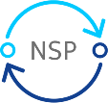
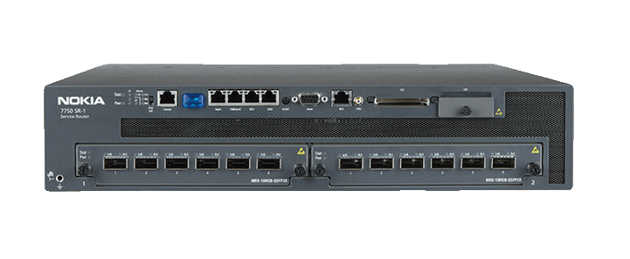
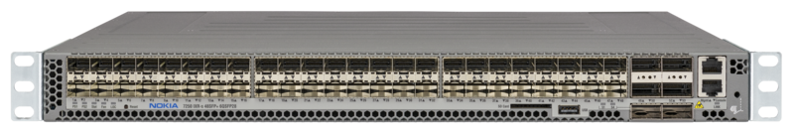

OAM Based CCCL - Cognitive Closed Control Loop
Digital Twin AI Agent
OAM based CCCL - AI Agent
NSP API and Event/Alarm AI Agent
https://network.developer.nokia.com/api-documentation/
1
NSP APIs
1
3
2a
Alarms
API + Notification/Events
2b
Notification /
Telemetry Data Feed
2a
2b
IP/Optical
Controller
3
Artifacts APIs
Service Model
Service
CoT: Chain Of Thoughts based Reasoning
SAPs
Transport
SDPs
PE/BNG/Transport Routers (7750/7250)
MCP based Multi AI Agents Collaboration
LSP Tunnels
LLM
LSP Paths
Optical service
IGPs
LLIs
Optical Domain
CDLs + Optical Service
Optical Physical Links: OMS/OTS

Slide 19
Q&A
Notes:
Impactful Advanced ML Use Case deployment still nascent in many customers
Everyone needs an AI Strategy; one key pillar of that strategy is that not all problems should be solved with AI
Technology looking for a problem, identification of killer use cases still under investigation by customers
Dealing with hallucinations & probability is common → Robust Validation Strategy
Network automation use cases traditionally rely on deterministic outcomes – managing hallucinations & probability needed
GenAI - A combination of a RAG with fine tuned LLMs provides the best results (so far).
Response Validation and Reinforcement Learning with Human Validation required
Data is the Fuel
A robust Data Strategy is key – generation, collection, storage, curation and processing and sharing
Data required to be voluminous, diverse, complete & consistent.
In all the experiments we had to curate, generate, correct and enrich data.
Use cases bring their specifics to use data, hence diverse strategies are required for chunking, embedding & ingestion of data.
Governance and privacy of data
Diverse deployment models
- Target on-premise and cloud options
** conversation point with the customer on their preference.
Compliance
Streamlined Legal and Security Compliance frameworks
Staff & Process to help product teams navigate the process to accelerate safe productization
Ethics and regulation
Consistent Tool Frameworks
Expedite experimentation
LLMOps tooling – optimize lab usage
Rohit:
Oh a few observations while we were experimenting with this I’m sure generative AI something which you all are kind of looking at and some capacity or the other. There are a few observations. It’s a good topic for sure. We do see that in telecom space adoption is that it’s nice like the technology is good we are looking at how to kind of take the cases and bring it to production so that everyone could be benefitted out of it very important what Sasha told is the fuel if you put garbage in to the last model, you get garbage out so working on your data architecture and getting your data cleaned is very very very important. Your deployment models can be diverse like you may want to air gap model versus hybrid model versus kind of model so the juries open which which one is the best of the right I think, depending on the time and the case, one is better than the other, the tooling it’s a good time to actually look and invest into the tooling so that you have the tooling frame your model evolution will continue your cleanup will continue but your tooling is kind of consistent and you can just all those improvements right so that’s that’s one observation a lot of time to talk with your lawyers because compliance to corporate guidelines to ensure that you don’t kind of pass away data which is critical some large language model is is very key last, but not the least very robust validation strategy is required because there’s a there’s you might have seen the GPT also hallucination is is real There are ways to contain it, but having a validation strategy would help the accuracy those refuse observations which we should share

Slide 20
End frame

